Slide 1
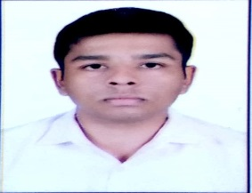
Tuhin Das
Main Focus
Photo
Primary Skills:
Java, AWS lambda, SpringBoot
Secondary Skills:
NodeJs, HTML, CSS, jQuery
Industries worked for:
DCP, In-house development environment of Capgemini.
Tuhin Das
+91-8348105724
tuhin.a.das@capgemini.com
Education Details
A Brief Summary of Experience
Qualification: B.Tech
Institute : Academy Of Technology, West Bengal
Year of Passing : 2016
Client/Project type : DCP
Description : Worked as developer in developing multiple Use Cases
1)Omni-Channel Interaction: Built a chatbot using AWS Lex which is communicating with AWS RDS instance via AWS lambda. And it uses serverless functionalities which internally creates S3 bucket to store the codebase and AWS cognito through CloudFormation.
2)Restaurant Order Management: Developed a use case using API gateway and AWS lambda, which store user face image, and recommend food items to the user based on weather of the user location , time of the user location, past order of the user.
3)DB Management : Switchover between two databases(MySql and MongoDb).
4)Iot predictive maintenance : Gives an insight of real time failure probability, The probability generated by using Machine survival algorithm.
Tools used : AWS Console, Serverless Cli, SpringBoot,MySQl WorkBench.
Profile Summary
Having 2+ years of IT experience with 1.5 Years of Hands on Experience in SpringBoot,Cloud native services.
Having hands on experience on AWS services, Specially on Amazon Elasticsearch Service, Amazon S3 buckets, Amazon Lex Bot, AWS Lambda, Amazon API Gateway APIs, Amazon Cognito, Amazon Kinesis Data Firehose
Work Experience in development and implementation of Applications using Java, Databases(MySql,MongoDb,DynamoDb,Redis).
Work experience in development and implementation of application using Angular,NodeJs.
Knowledge in all aspects of the SDLC including requirement analysis, design, development, Testing and debugging.

